Slide 1
Compliance Assessment Tool For Privacy Law Adherence

Slide 2

Facts and Trends in Global Data Protection Laws
Organizations fined under GDPR have paid over €2 billion in penalties since its inception, with the largest single fine reaching €1.2 billion (against Meta in 2023).
84% of consumers say they are more likely to trust companies that demonstrate strong data protection practices. (Source: Cisco Consumer Privacy Survey, 2023)
The average cost of a data breach globally reached $4.88 million in 2024, highlighting the financial importance of compliance with data protection laws. (Source: IBM Cost of a Data Breach Report, 2023)

Slide 3

What Are Privacy Laws?
Regulations designed to protect personal data and ensure ethical usage.
Key Privacy Laws Around the world
Digital Personal Data Protection India
Personal Data Protection Law Saudi Arabia
Personal Data Protection Policy Oman
National Data Privacy Law Qatar
General Data Protection Regulation Europe

Slide 4
Common Themes
Compliance Themes Across Data Privacy & Protection Laws (e.g. EU GDPR, Saudi PDPL etc)
Consent
Notice
Impact Assessment
Processors
Accuracy
Record of Processing
Lawful Collection
Disclosure
International Transfers
Minimization
Storage Limitation
Data Protection Officer (DPO)
Security
Individual Rights

Slide 5
The Need for Compliance Assessment Tool
Complexity
Privacy laws like GDPR, PDPL, and DPDP are complex and constantly evolving.
Risks
Non-compliance leads to hefty fines, reputational damage, and legal risks.
Challenges
Manual processes are slow, error-prone, and resource-heavy.
Benefits
AI Automated tools ensure accuracy, scalability, and efficiency.
Adaptability
A compliance tool helps organizations stay audit-ready and adaptable. give title for this

Slide 6
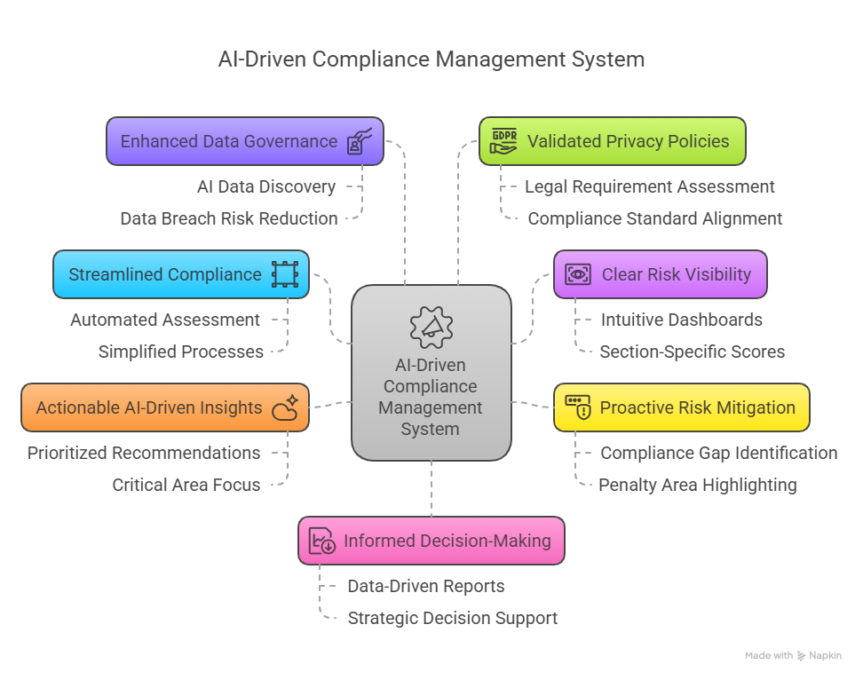
Value and Impact of the Tool

Slide 7
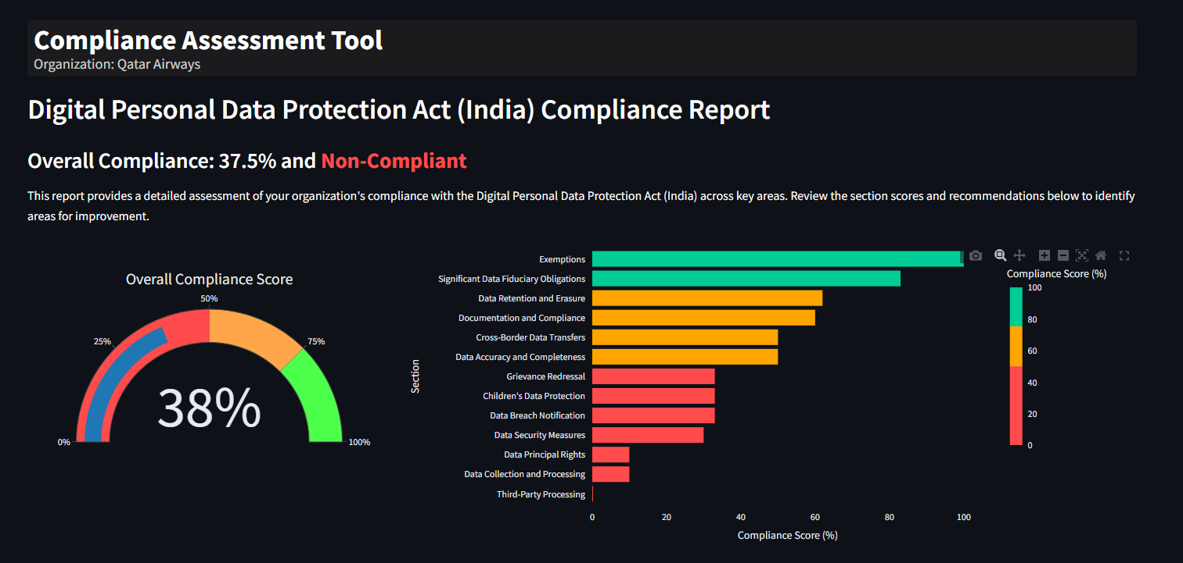
Features of the Compliance Assessment Tool

Slide 8
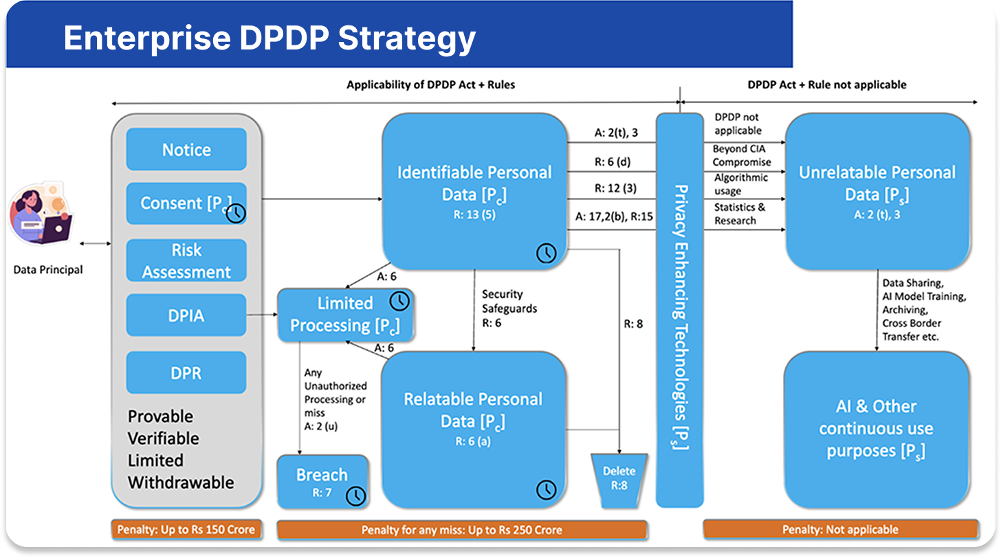

Slide 9
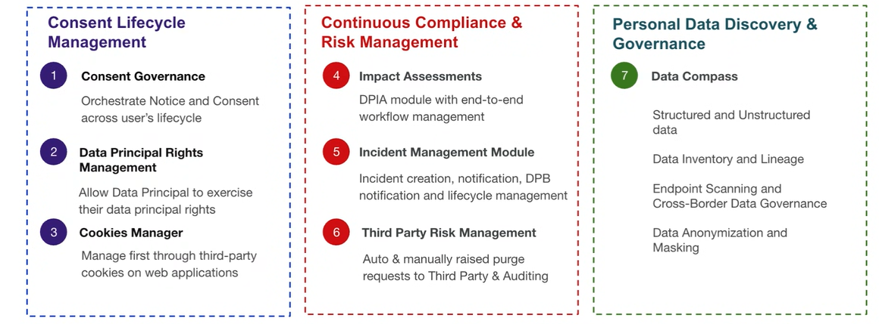
A Complete Solution for DPDP

Slide 10
Data Lifecycle Support for Compliance
True champions of Data Management
Data Collection
Discover and Manage digital personal data estate with data minimization, process limits and storage rules
Data Label
Data gets Protected based on Policies, Data Principal Rights are managed, and data exposure is remediated for effective data protection. protection.
Data Activity Monitor
Data processing ensures minimization, tracks lawful activities, manages Data Principal Rights, and remediates data exposure.
Data Delete/Retired
Data gets Collected from various sources
Data Discovery
Data is Labelled based on Sensitivity and tracked for access rights and accuracy, and appropriately protected, including children’s data.
Data Protection
Monitor Data transfers, enforce location-based access, and respond to unauthorized data activities.
Personal Data Process
Manage data retention and lifecycle, mark documents as "Records," and conduct disposition reviews for safe deletion.
Informatica Cloud Data Governance (CDGC), Metadata Command Center (MCC), Informatica Cloud Data Profiling (CDP),
Informatica Data Privacy Management (DPM)

Slide 11












Industry’s Only Intelligent Data Management Cloud
Informatica Intelligent Data Management Cloud
DATA
CATALOG
DATA, API & APP INTEGRATION
DATA
QUALITY
MASTER DATA MANAGEMENT
CUSTOMER & BUSINESS 360
GOVERNANCE & PRIVACY
DATA
MARKETPLACE
Pattern-based Learning
Auto- Curation
Data Recommendations
Data Sensitivity
Inferred Relationships
Protection Policies
Mapping Recommendations
Sourcing Recommendations
11 Petabytes of Active Metadata
Organization, Industry, Data Domains, Applications
AI-Powered Metadata Intelligence & Automation
Connectivity Metadata System of Record
SaaS
Self-Managed
On-premises
Enterprise Cloud

Slide 12















Clients Who Trust Us With Their Data
India
USA
UAE
India
Qatar
UAE
ME
UAE
ME & Africa
Qatar
India
India
USA
UAE
India & USA

Slide 13
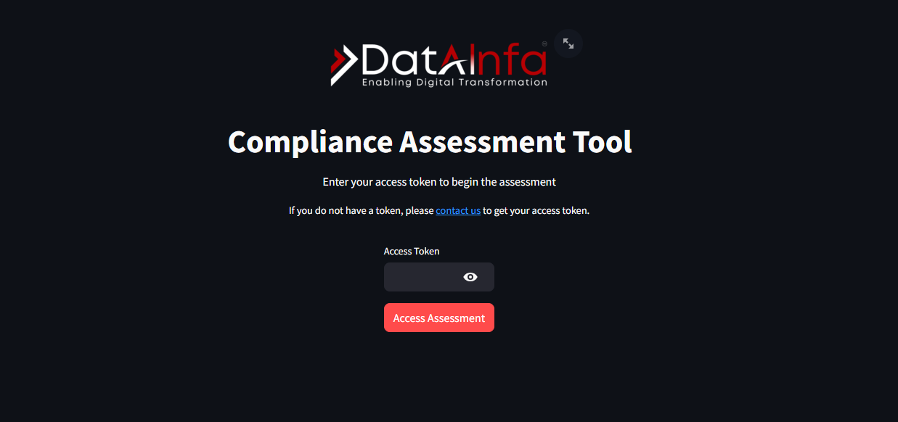
Sneak peek into our Compliance Assessment Tool

Slide 14
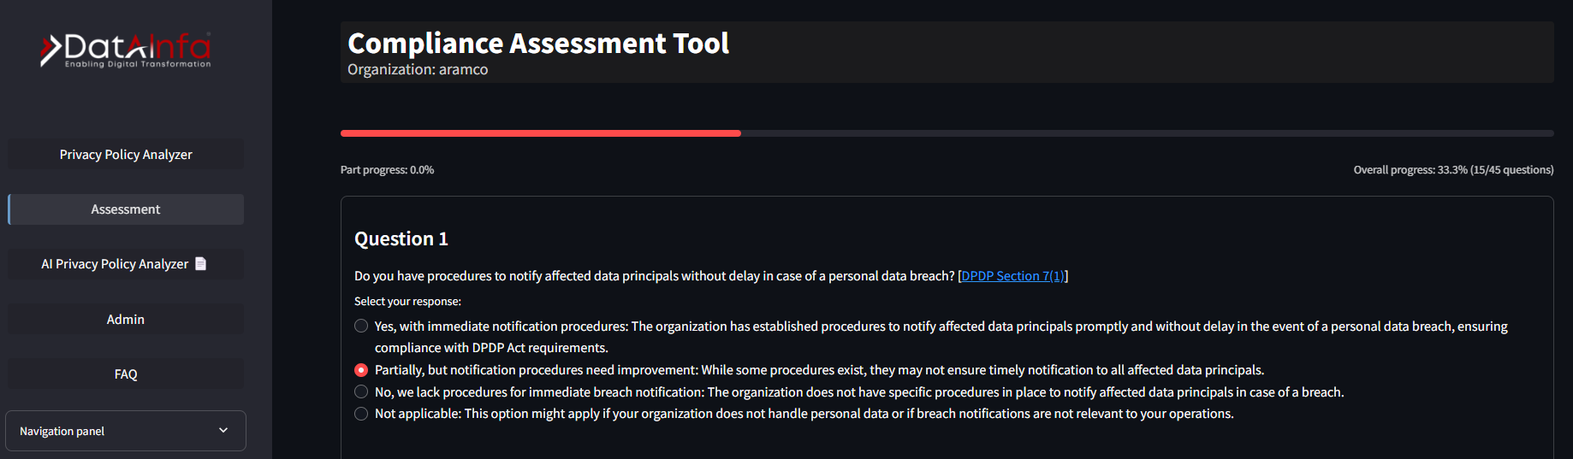
Sneak peek into our Compliance Assessment Tool

Slide 15
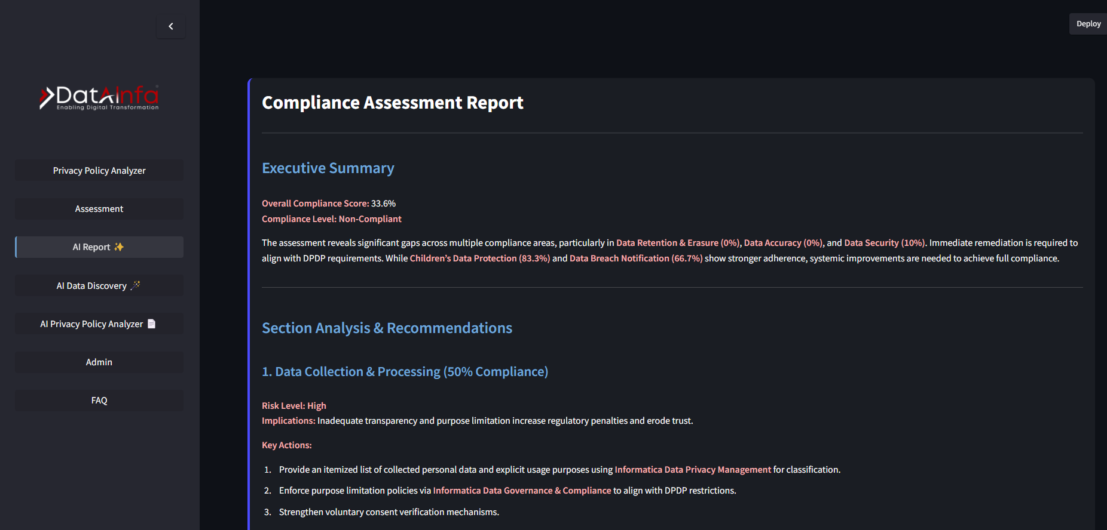
Sneak peek into our Compliance Assessment Tool

Slide 16






Thank You
LOCATIONS
India | Dubai | USA | Saudi Arabia | Singapore | Australia
EMAIL
info@datainfa.com
PHONE
+91 8320393920 | +91 8588845077 | +91 8861143928 | +971 585600941
www.datainfa.com

